Slide 1

TEVEL GROUP-COMPANY INTRODUCTION

Slide 2
CONTENTS
01
COMPANY
02
HISTORY
03
LITERATURE
04
INOVATION
04
05
BRAND
INTERNATIONAL
TRADE
06
07
CULTURE

Slide 3
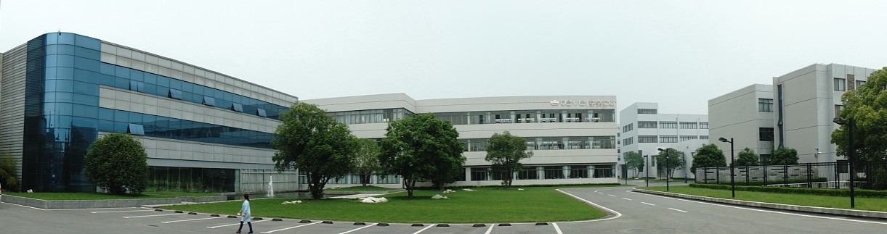
COMPANY
Tang Huang Group was established in 1986. As vice president of China Household Textile Industry Association, TEVEL participated in the drafting of many national industry standards. With profound technology accumulation, world-class product design and strict enterprise management. TEVEL has won many honors, such as “China’s Famous Brand” and “ China’s top Brand Product” etc. TEVEL’S products sell well in more than 20 countries and regions, such as Japan, Italy, Brita, France, Spain, France, Spain, Canada, the USA, Chile and so on, and let the people around the world share a healthy, comfortable and tasteful household life.

Slide 4
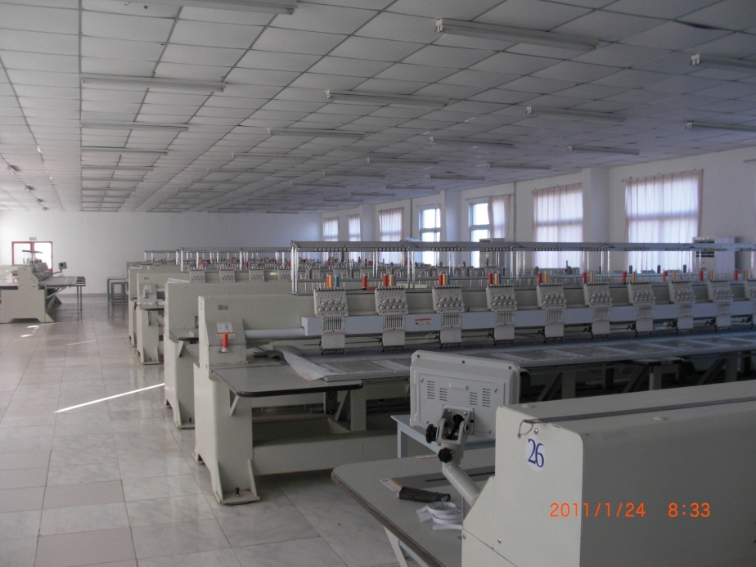
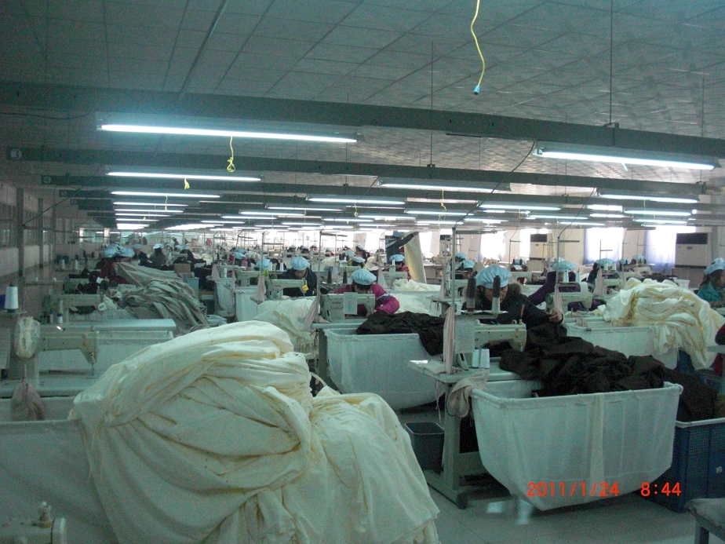
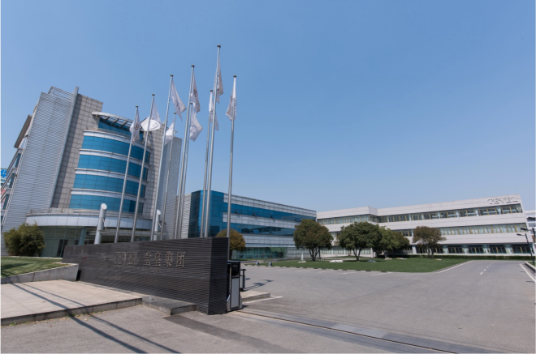
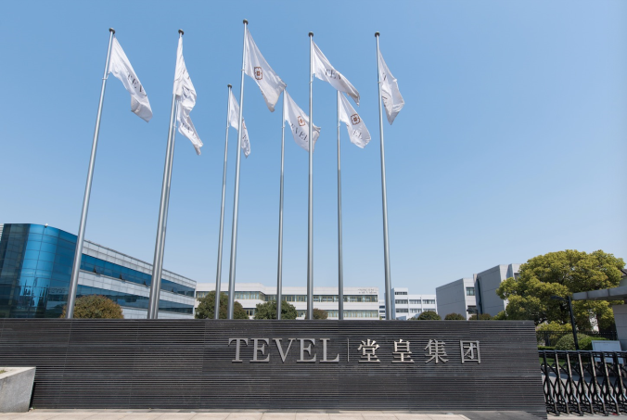
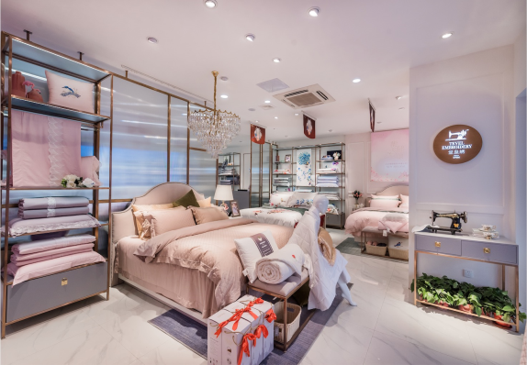


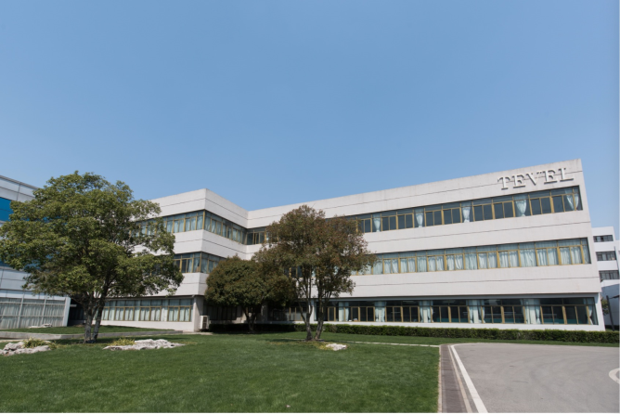
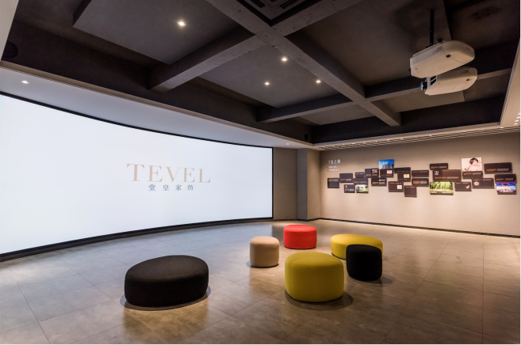
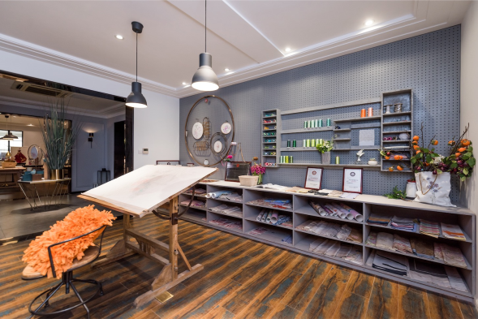

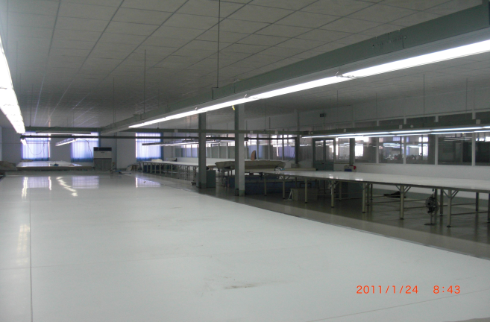

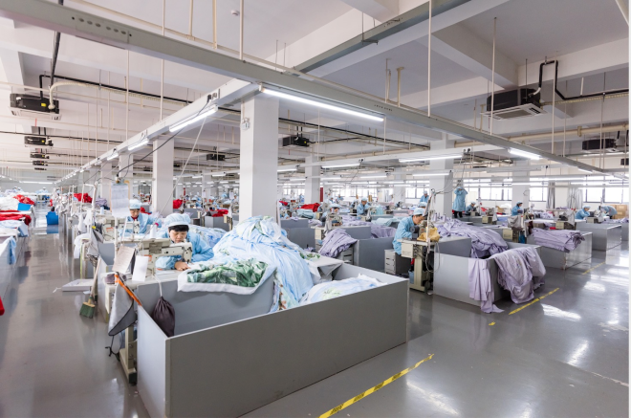
COMPANY （Vedio link）
Head Office
Cover 50000m2，owns standard workshop with manufacture, design, sales and
Lian yuangang
50000 M2 for production workshop
Changzhou office
Branch for Sales&RD department

Slide 5
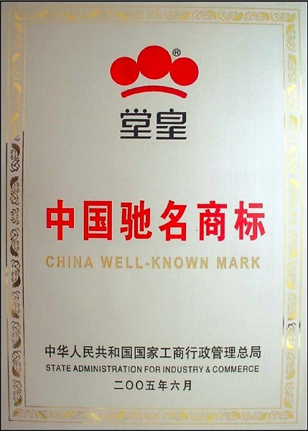
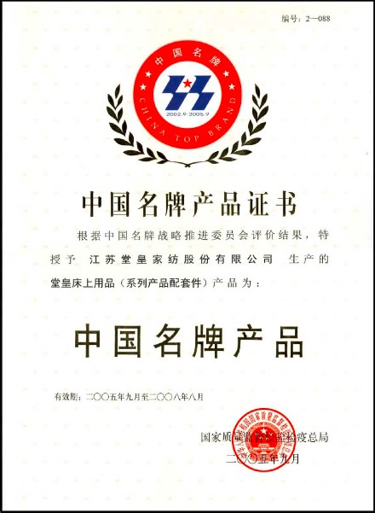
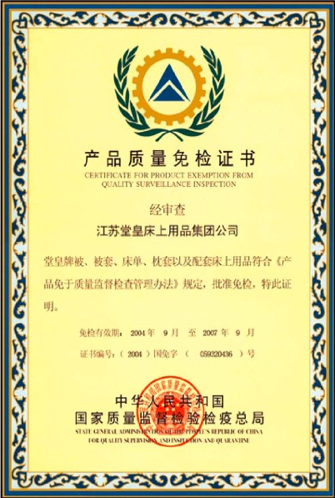
LITERATURE
CHINA WELL-KNOWM MARK
CHINA FAMOUS BRAND
NATIONAL INSPECTION EXEMPTION

Slide 6
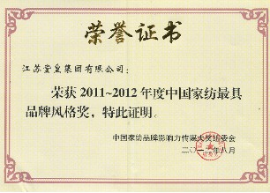
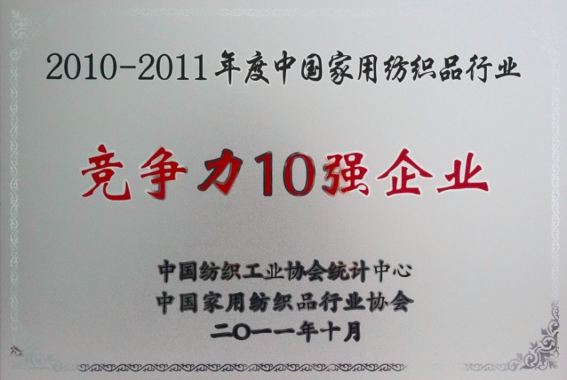

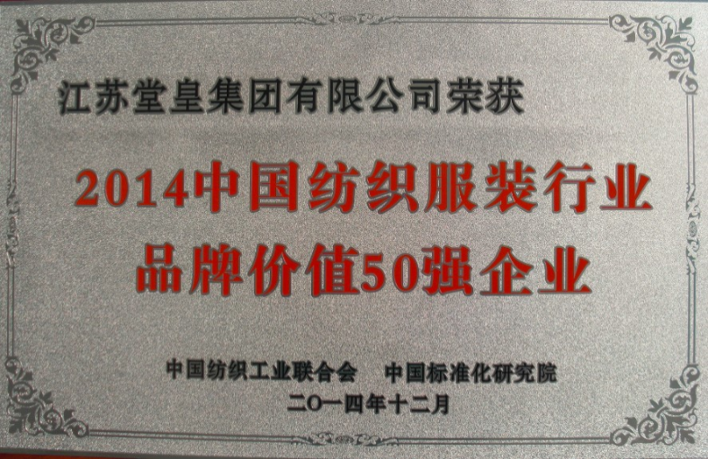
LITERATURE-BRAND VALUE
TOP 10 IN COMPETITION
TOP 50 IN BRAND VALUE

Slide 7
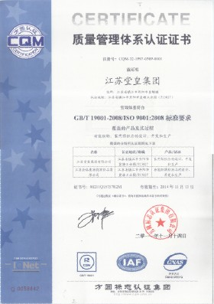
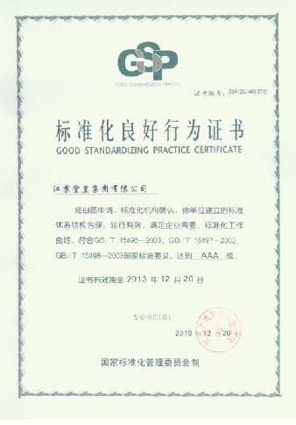
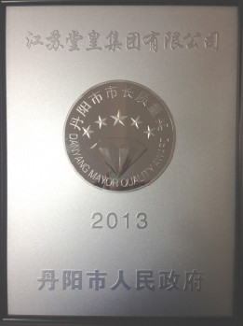
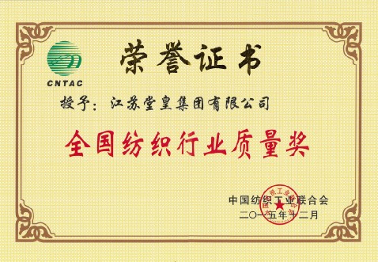
COMPANY-MANAGEMENT
National Textile Industry
Quality Certificate
ISO9001
System Certification
Standardize
good behavior
enterprise certificate
Zhenjiang quality certificate

Slide 8
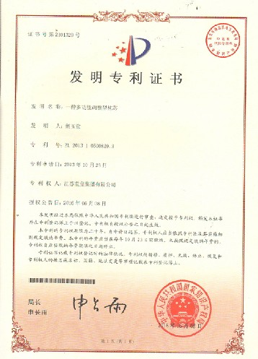
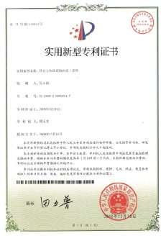
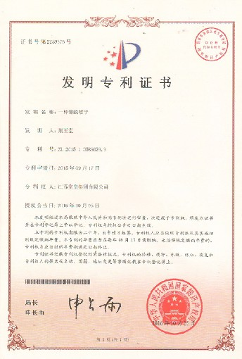
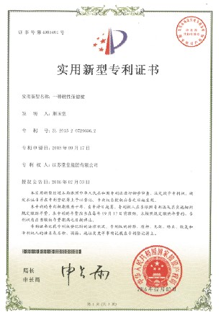
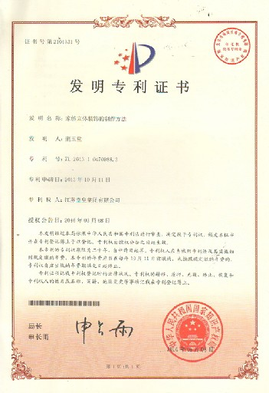
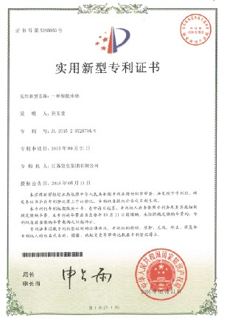
LITERATURE -PATENT
PATENT
8 INVENTION PATENT
20 UTILITY MODEL PATENT
1000 APPWARENCE PATNT
STANDARD
4 NATIONAL STANDARD DRAFTING

Slide 9

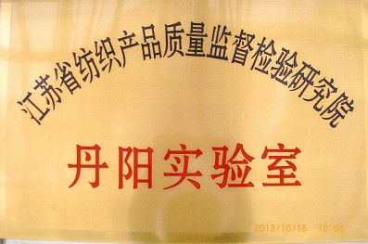
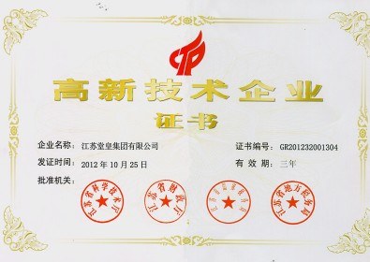
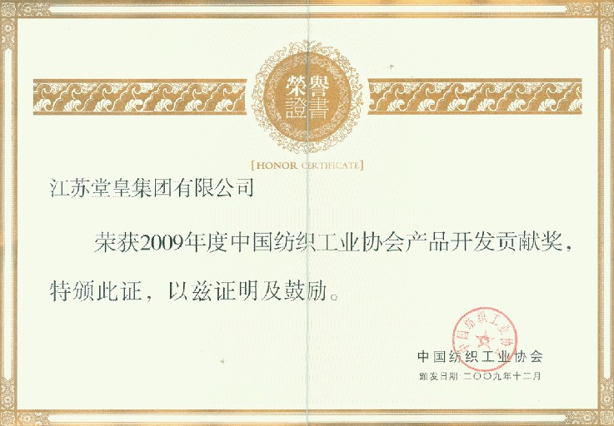
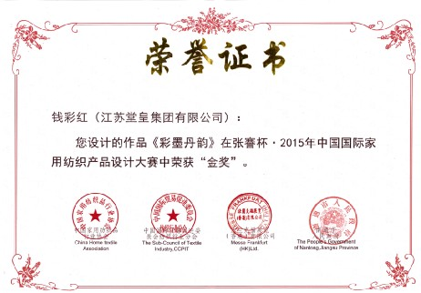
TECHNOLOGY&INNOVATION
HIGH LAB CENTER LAB
TECHNOLOGY
ENTERPRISE REWARD CERTIFICATE

Slide 10
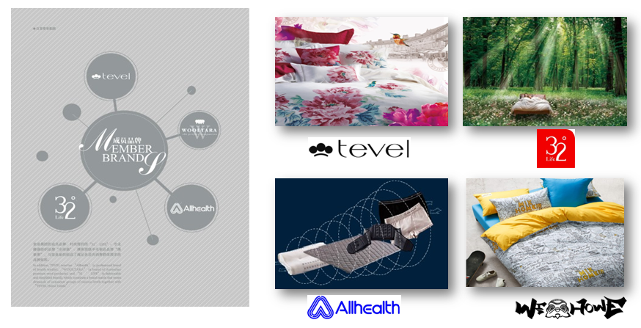
BRAND

Slide 11
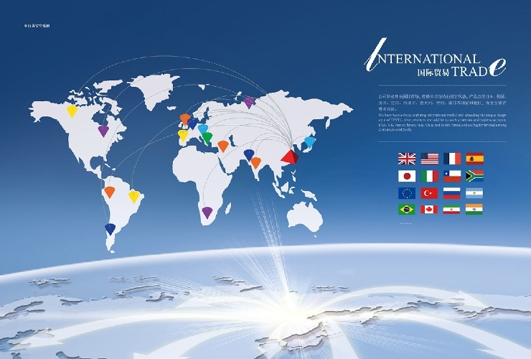
INTERNATIONAL TRADE

Slide 12









INTERNATIONAL TRADE-NORTH AMERICA（USA、CANADA）

Slide 13
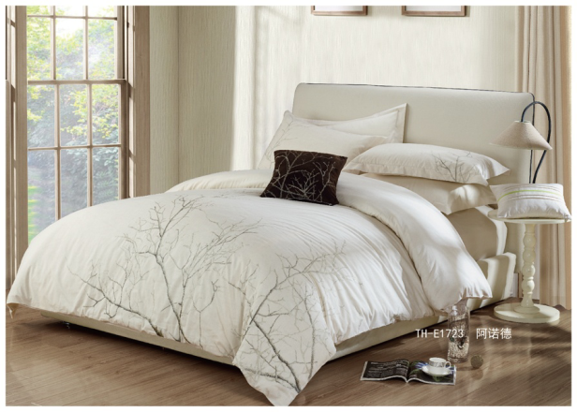
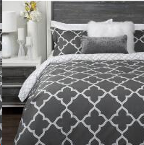
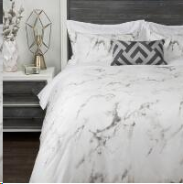
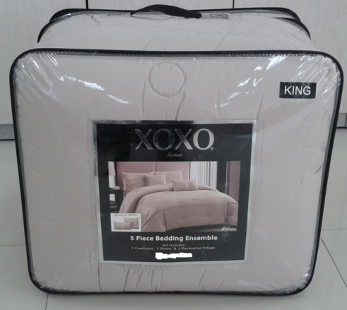
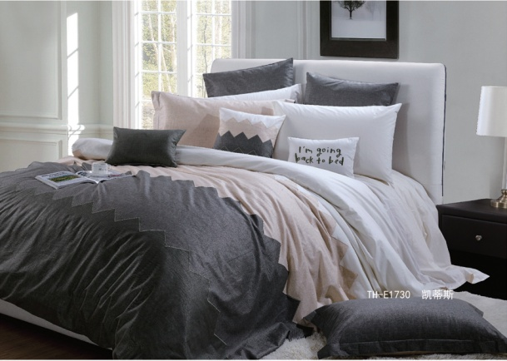
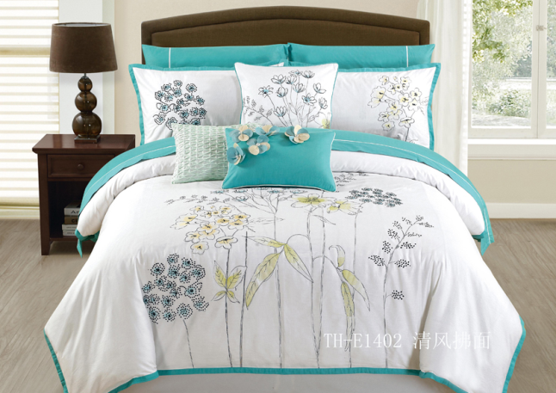
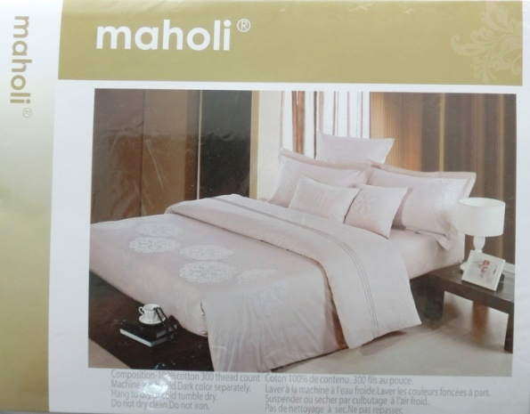
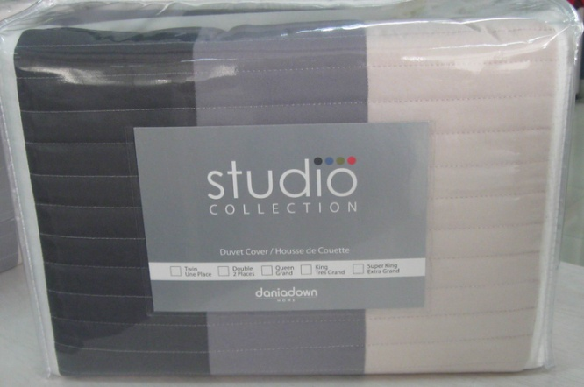
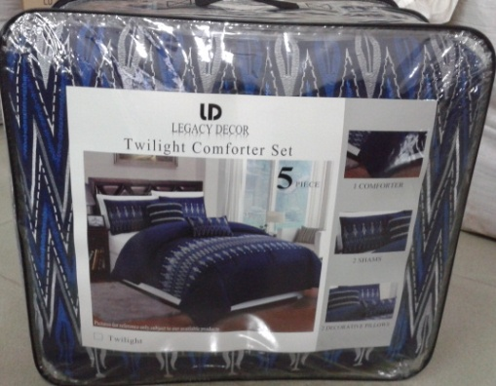
INTERNATIONAL BUSINESS-NORTH AMERICA
PRODUCT:
COMFORTER SET
DUVET COVER SET

Slide 14






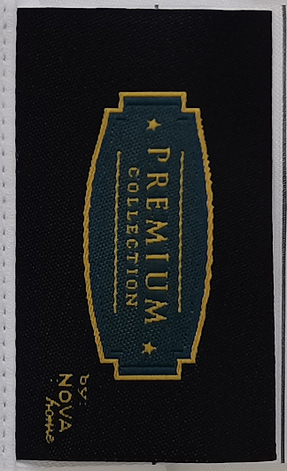

INTERNATIONAL BUSINESEE-ASIA(JAPAN、UAE, SAUDI ARIBA,INDONESIA ETC）

Slide 15
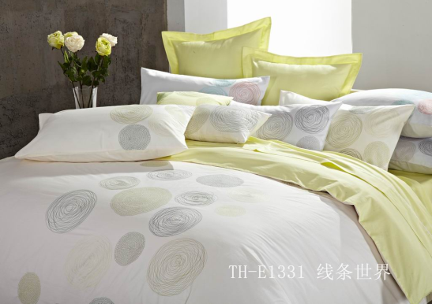

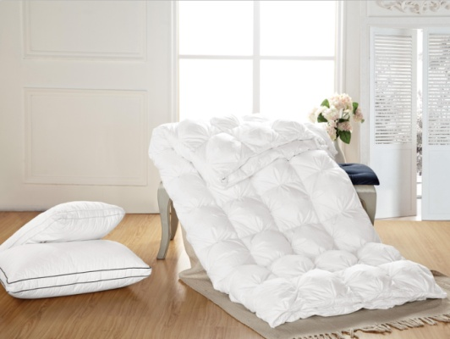
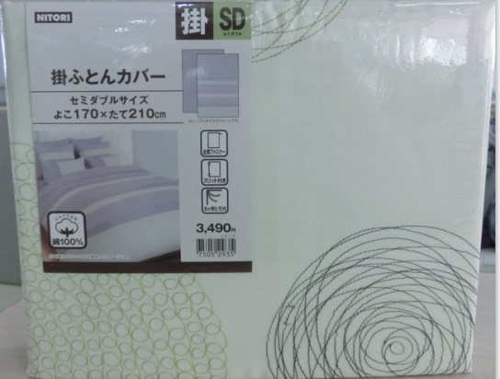
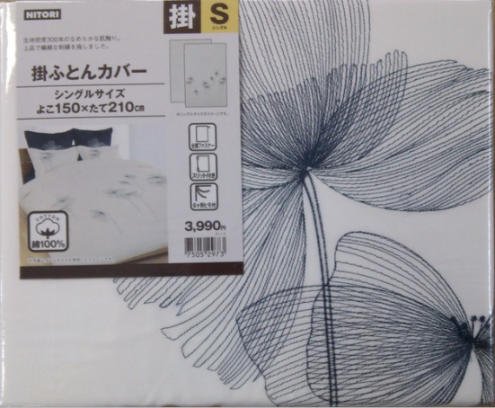
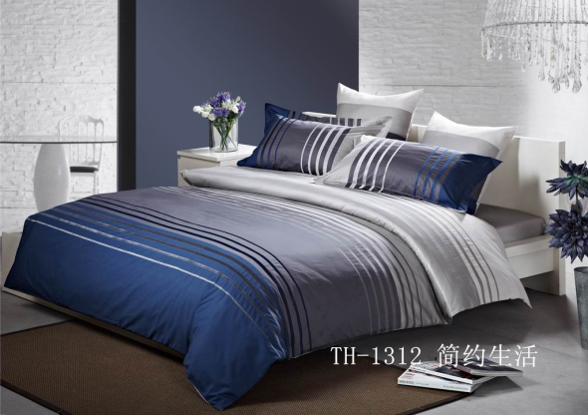
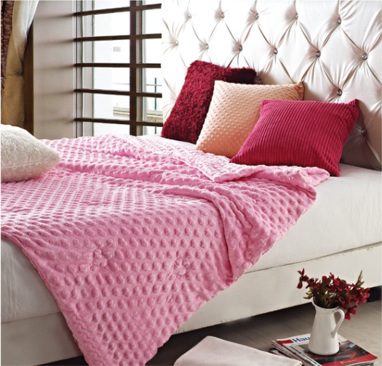
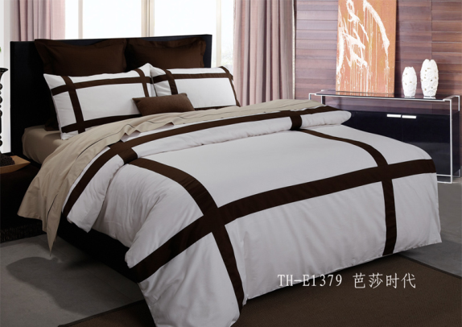
INTERNATIONAL BUSINESS-ASIA
PRODUCT:
QUILT COVER SETS、
BLANKETS

Slide 16

INTERNATIONAL BUSINESS-SOUTH AMERICAN(CHILE, ARGENTINA,
BRAZIL, PERU, ETC.) AND AUSTRALIA MARKET
COOPERATED BRANDS
Notes:
标注：ROSEN是南美第二大家纺零售商，分为线上和线下销售，产品档次为中高端全棉，在智利、秘鲁、阿根廷均设有店铺销售，年采购量约50万套

Slide 17







INTERNATIONAL BUSINESS -SOUTH AMERICA
PRODUCTS:
DUVET/SHEET COVER SET

Slide 18





INTERNATIONAL BUSINESS-EUROPE(CHILE, ARGENTINA,
BRAZIL, PERU, ETC.) AND AUSTRALIA MARKET

Slide 19








INTERNATIONAL BUSINESS - EUROPE
PRODUCTS：
COVER SETS、CUSHIONS

Slide 20


